Slide 1
Credentialing Creativity Session
Moderator LeAnn Morris
May 2, 2018
10:30 am

Slide 2
Credentialing Which “Waze” is the Dental Industry heading?

Slide 3
Introductions to our Panelists
Art Schoen
Marian Sipe
Scott Everline

Slide 4
Art Schoen
Aspen Dental
The Challenges of supporting 680 locations, pain points of past inefficiencies,
decision for delegated credentialing and improved processing today!
Like WAZE, warning! Warning; hazards ahead…

Slide 5
Marian Sipe
Park Dental, Insurance Manager
Supporting 150 + locations located in Minnesota
Representing large provider groups
Just like Waze, we have gone down many wrong roads…….

Slide 6
Scott Everline
Manager, CAQH
What we bring to the dental industry,
provider and payer solutions

Slide 9
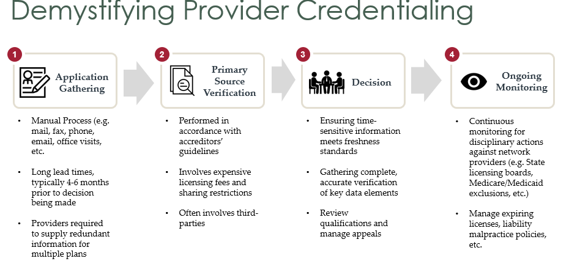

Slide 10
Where did we get lost along the way?
Payer Delays in Approval
Inefficiencies due to lack of provider knowledge in each and every payer, completion of lengthy applications
Quality control - 7 out of 10 applications received incomplete
Payer specific portals/applications driving repetitive data entry
Payer restrictions for multi-locations
Regulations about directory accuracy
Your hurdles and hazards?
Questions for our panelists?

Slide 11
U-turn, back to the Provider?
Additional staffing costs pushed back on the provider groups
Software costs to develop an all payer solution
Medical software modified for dental as an afterthought
Application management - mapping and tagging
Contract Management Functionality- provider reminders
Delegated processes/audits, unique by payer and or by group?
PSV and other documentation
Software to support a delegated process

Slide 12
NDEDIC, is there a place for us?
Credentialing to become the next transaction… beyond a vision?
Practice Management System enhancements?
Stand along software?
Single source national service organization to be the solution?
Clearinghouses? Exchanging data between providers, payers and CAQH as an added service?

Slide 13
What’s Next for NDEDIC?
Questions to panel and attendees

